Slide 1
Racism in Context:
A Brief History of Race and Racial Discrimination in St. Louis & Ferguson
SCC Panel on Ferguson
October 8, 2014
Prof. Grace Wade Moser

Slide 2
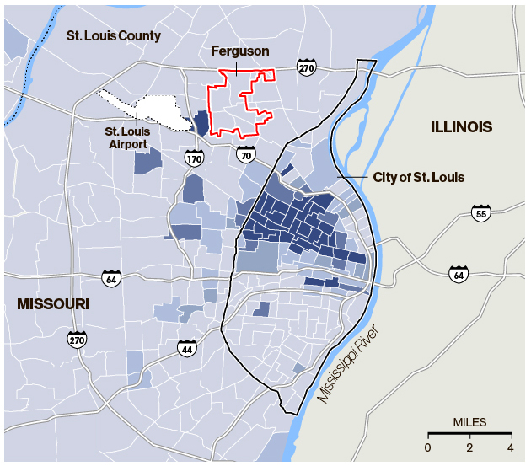

Ferguson 1970
“Why Ferguson Looks Like the Inner City” by James E. Ellis
Businessweek 8/15/14

Slide 3
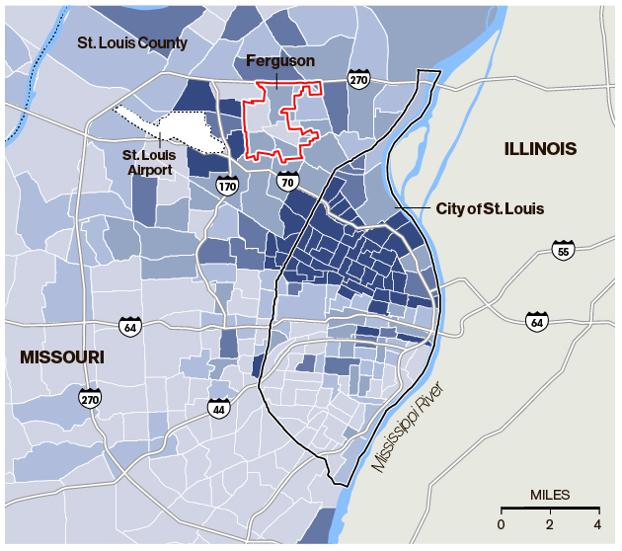
1990
“Why Ferguson Looks Like the Inner City” by James E. Ellis
Businessweek 8/15/14

Slide 4
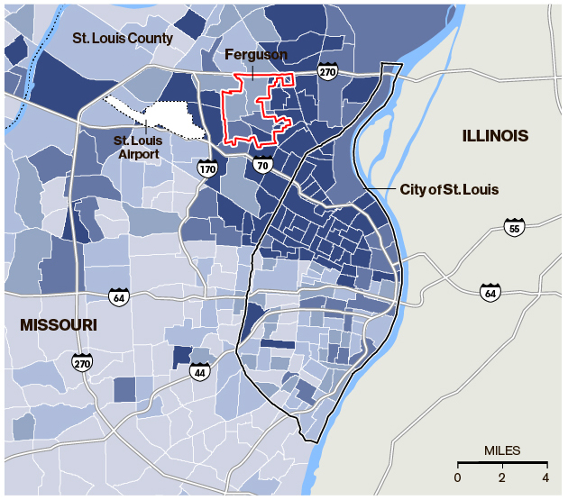
2010
“The County Map that Explains Ferguson’s Tragic Discord” by Peter Goy published 8/15/14 in Businessweek

Slide 5
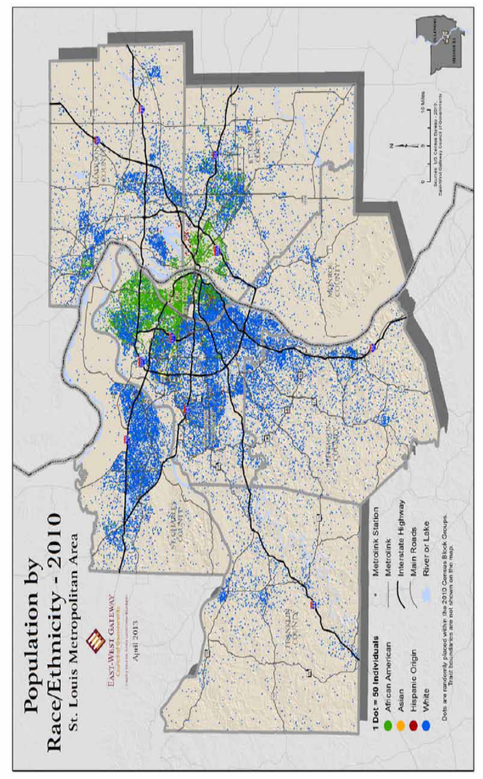
Source: Where We Stand, 6th edition, Update 9,
September 2014

Slide 6
Sources
Primm, James Neal. Lion of the Valley: St. Louis, Missouri, 1764-1980, 3rd ed., St. Louis: Missouri Historical Society Press, 1998
Where We Stand, 6th ed., update 9, St. Louis: East-West Gateway Council of Governments
Mueller, Mike. The Corvette Factories: Building America’s Sports Car. Minneapolis, MN: MBI Publishing Co., 2009.
Smith, Irene Stafford. Ferguson: A City and its People, Ferguson, MO: Ferguson Historical Society, 1976.

